Slide 1
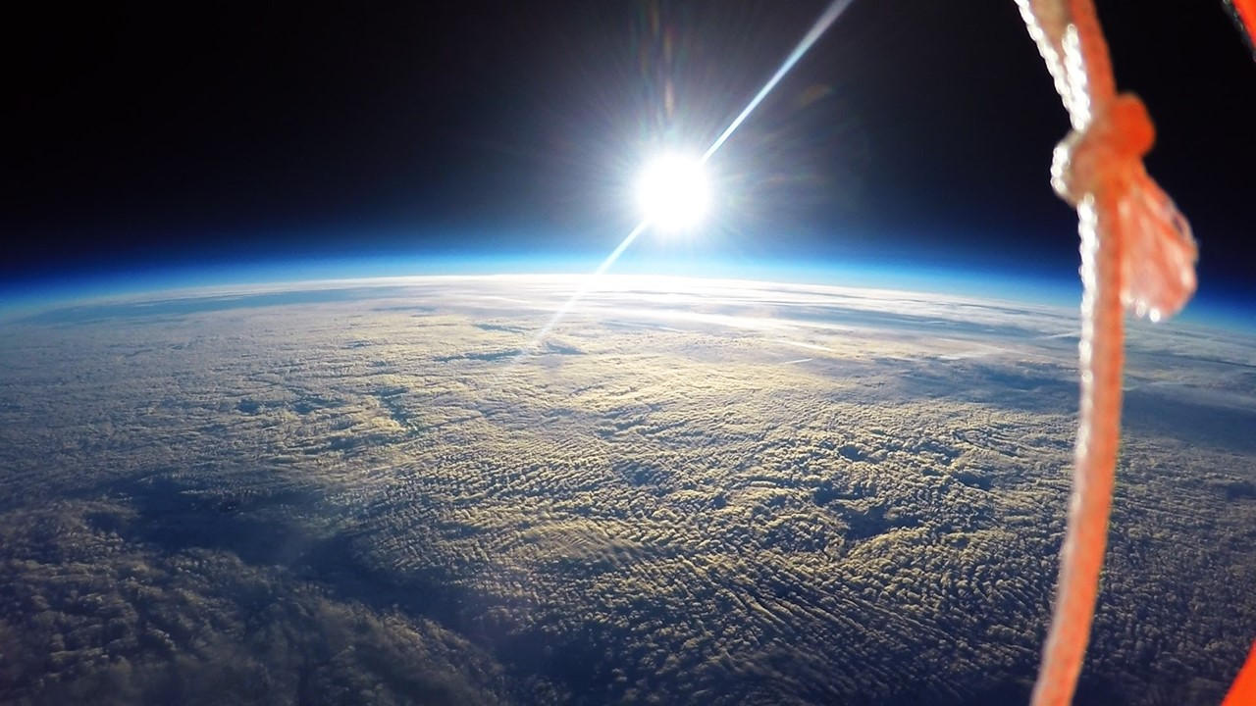




ASU ASCEND!

Slide 2
2019-2020 Crew
Christopher Yurgel, Project Manager
Anastasia Torres, Team Member
Alexander Sonke, Team Member
Ivan Martinez Morales, Team Member
Daniel Cross, Team Member
Matthew Johnson, Team Member
Christopher Canales, Team Member

Slide 3
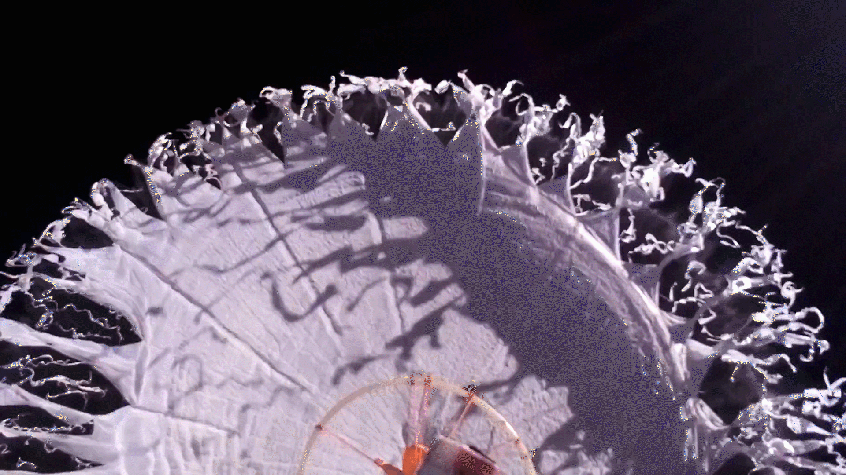

Slide 4



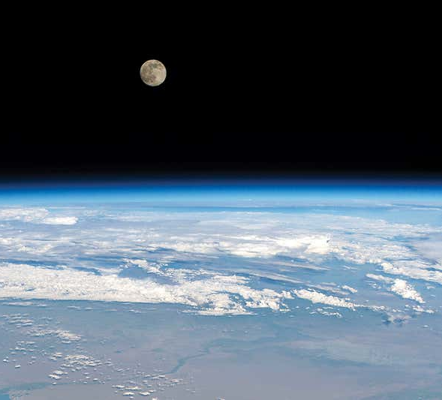



Mission Objectives
Obtain Normalized Difference Vegetation Index (NDVI) Data for Sonoran Desert Along Flight Path
Compare with historical NDVI Data
Design Lightweight Fiberglass Reinforced Housing Capable of Withstanding Flight Conditions
Film flight without interruptions due to temperature conditions

Slide 5
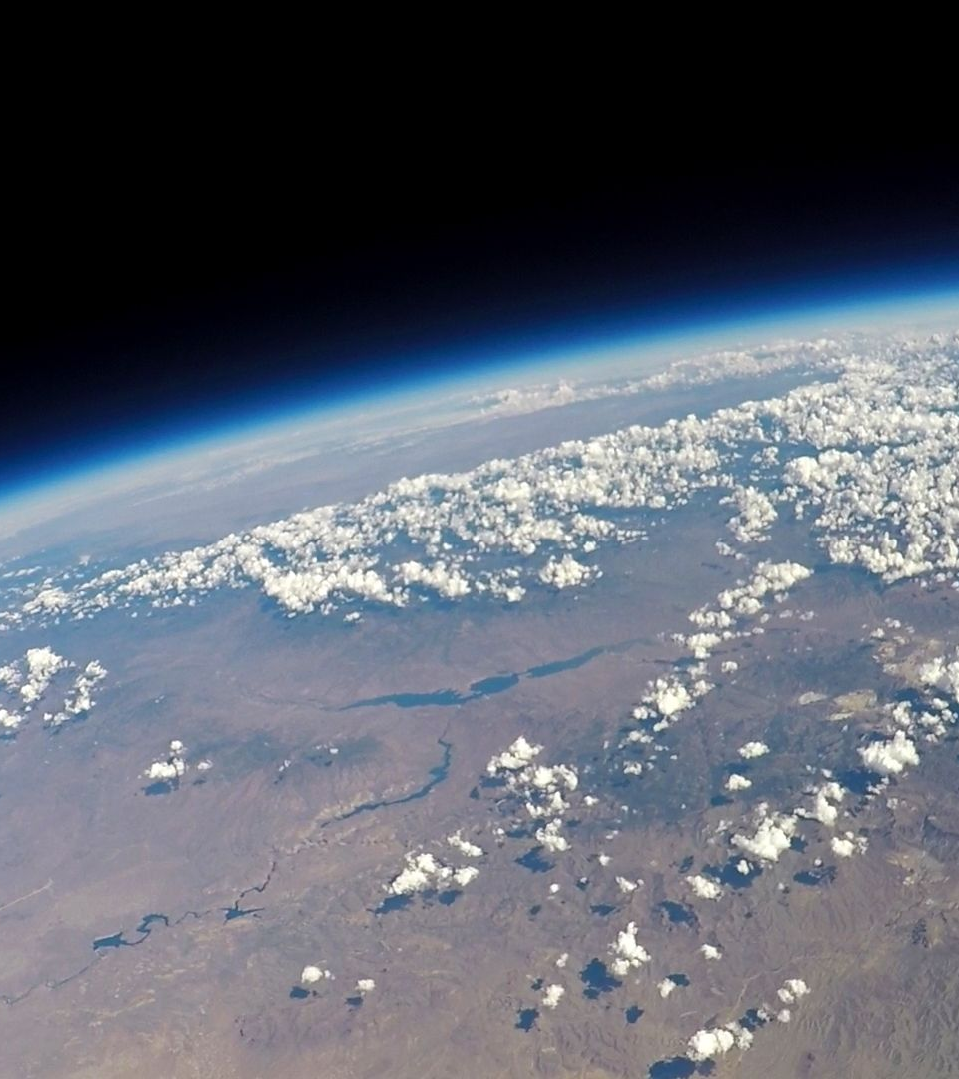
Components Breakdown
Electronics
  Cost-efficient, flexible, and reliable platform to obtain NDVI data
Structure
  Lightweight, impact resistant, and easy to manufacture payload housing
Power Source
  Anker Powercore Lithium Ion 20100mAh battery pack

Slide 6
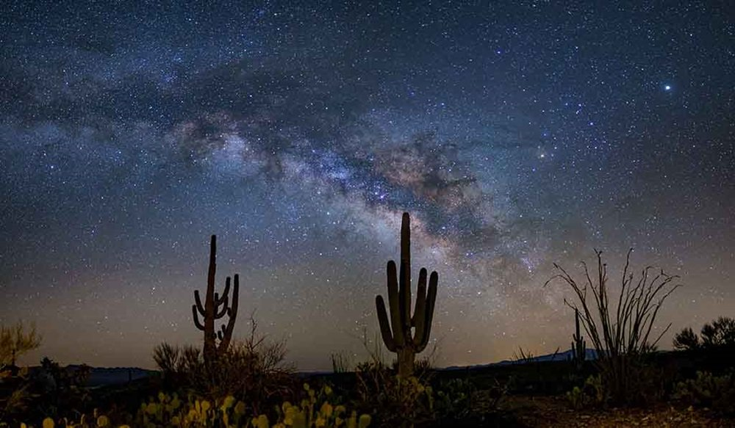
Imaging
Processing and Imaging
Double Raspberry Pi 0’s
Pi NoIR Camera V2
8 megapixel Raspberry Pi camera
Positioning
Data logging
Pixhawk 4 flight controller
Accelerometer, magnetometer, barometer
Reconstructs payload orientation throughout flight

Slide 7
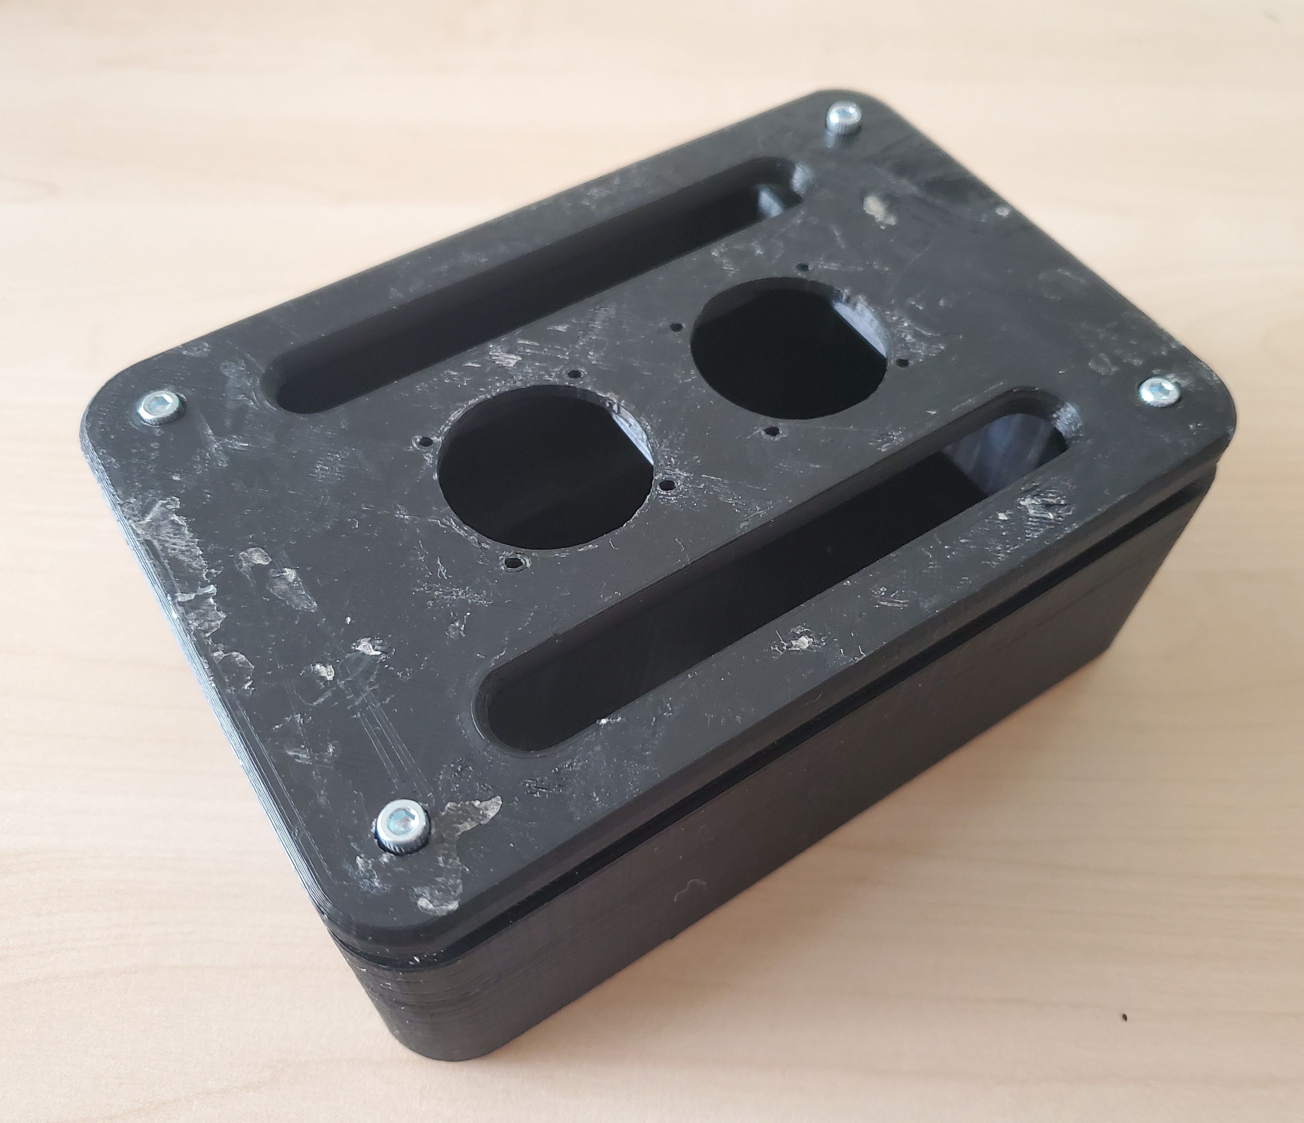
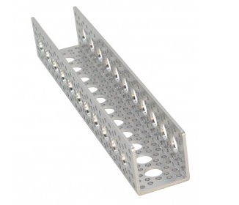
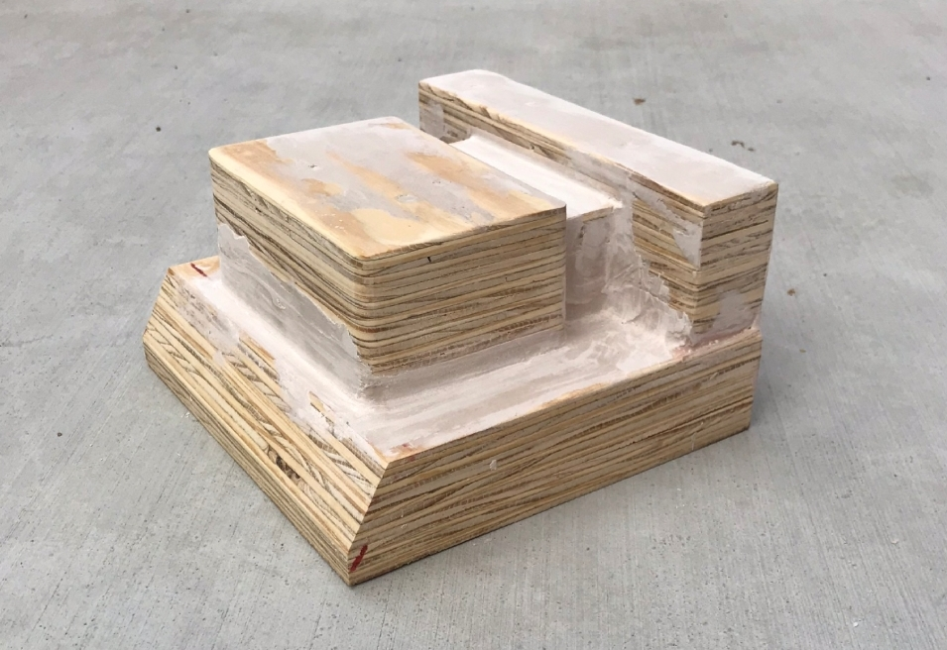
Construction Materials
  Constructed using a two mold technique
  8 ounce fiberglass sheets hardened with polyester resin
Reinforcement
  Reinforced with lightweight aluminum channels and balsa wood at critical locations
  If exterior housing fails components stay protected
Component Housing
  Lightweight 3D printed component housing
  Protects components from damage
  Temperature control through dual mounted 30mm fans

Slide 8
Fall Electronics Payload
Fall was intended as an exploratory period for ASCEND
Deployed payload with Raspberry Pi to determine feasibility of launching Raspberry Pi
Attempted to roll out use of Raspberry Pi 4, deployment went well but with issues
Insufficient ventilation even with fans running
Raspberry Pi 4 runs much hotter than Raspberry Pi 3
Raspberry Pi 4 can only handle so much data ingestion at once—unsuccessfully recorded video facing downwards
Able to recover video looking up towards the sky
Captured balloon burst

Slide 9
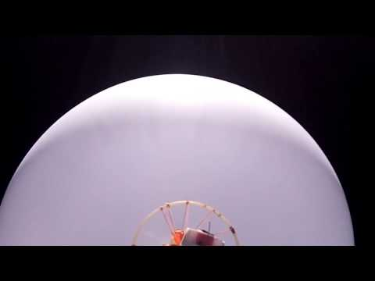
Balloon Burst Video

Slide 10
Goodnight Arduino, Hello Raspberry Pi.
Record relevant telemetry using Pixhawk 4
Pixhawk automatically logs GPS/Compass, IMU data for post mission processing
Able to leverage ROS to subscribe to Pixhawk data streams during flight (possible for use with GPIO headers on Raspberry Pi)
Used two Raspberry Pi 0 w’s to take photos at 30 second intervals from two cameras
Public Lab Infragram project was the basis of our scientific payload, allows us to make rudimentary NDVI measurements
Spring Electronics Payload Concept

Slide 11
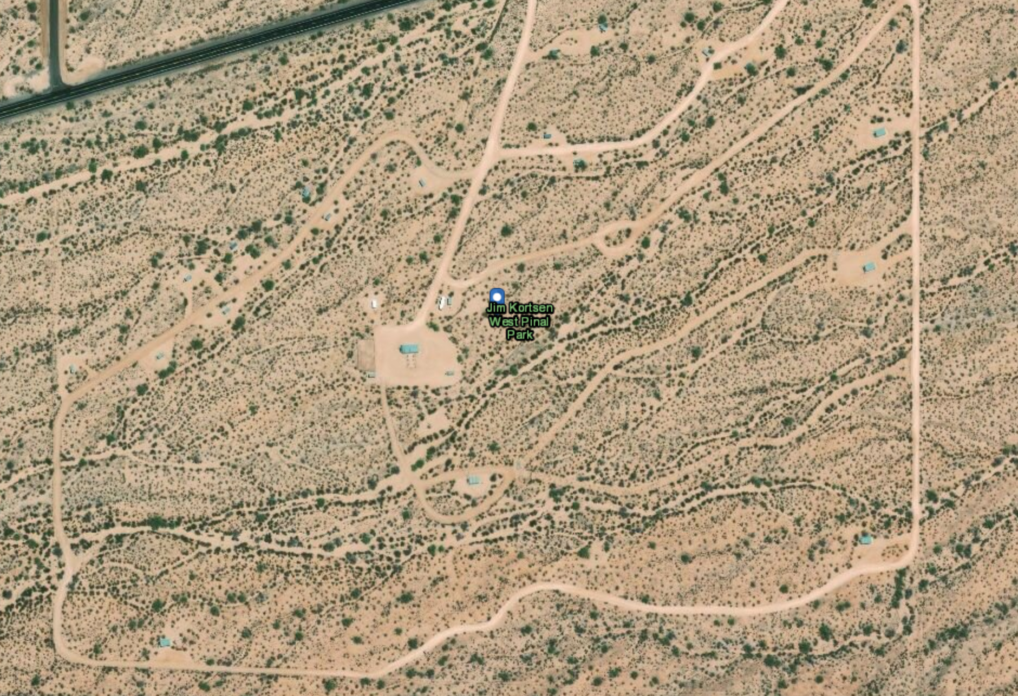
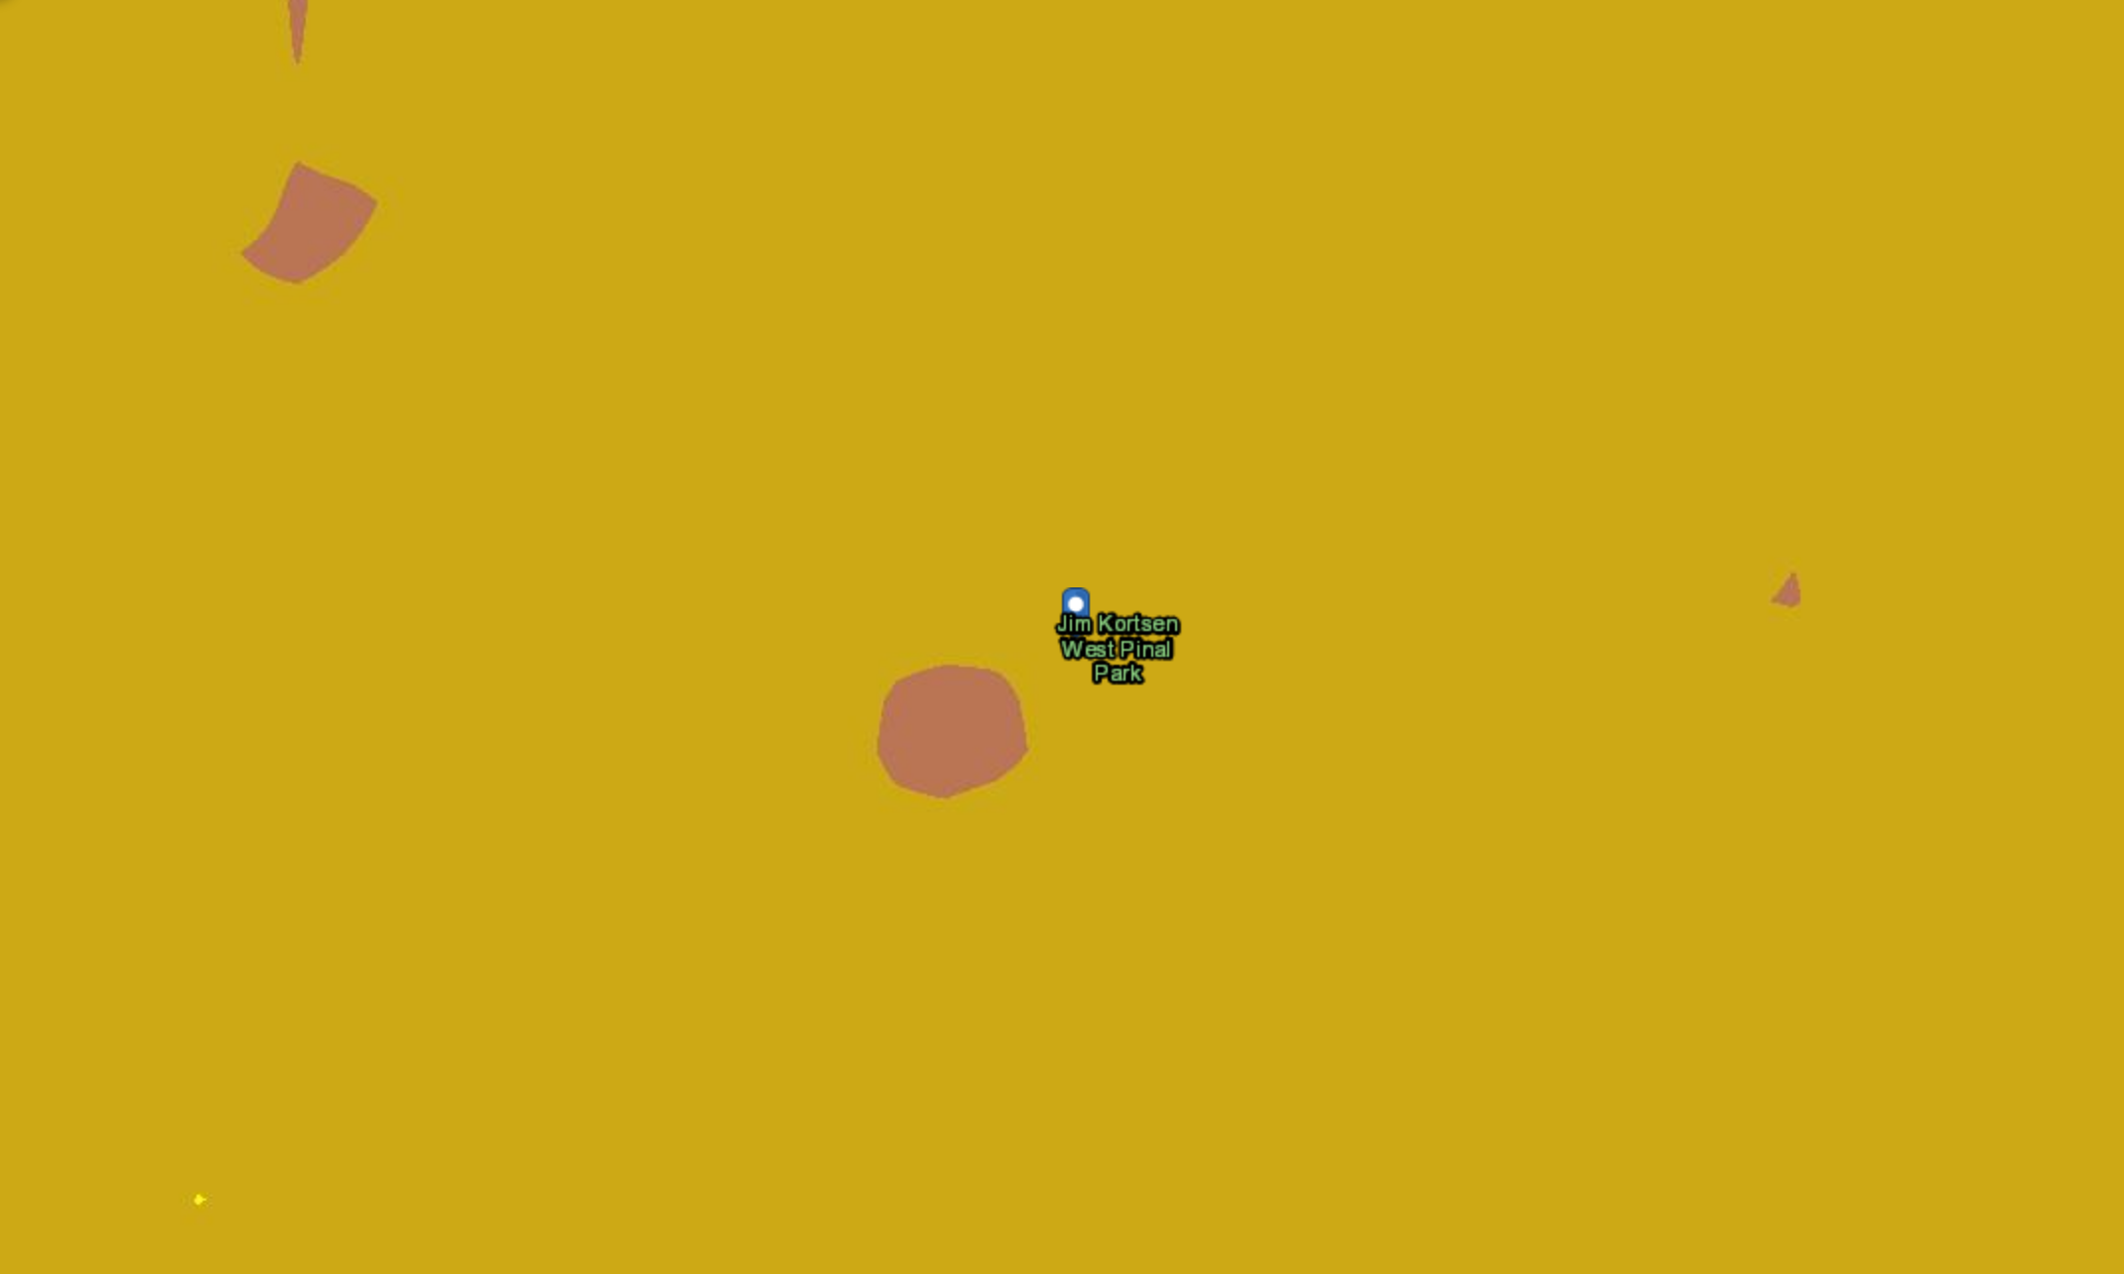
NDVI Imaging Resolutions
Launch site base map vs vegetation index

Slide 12
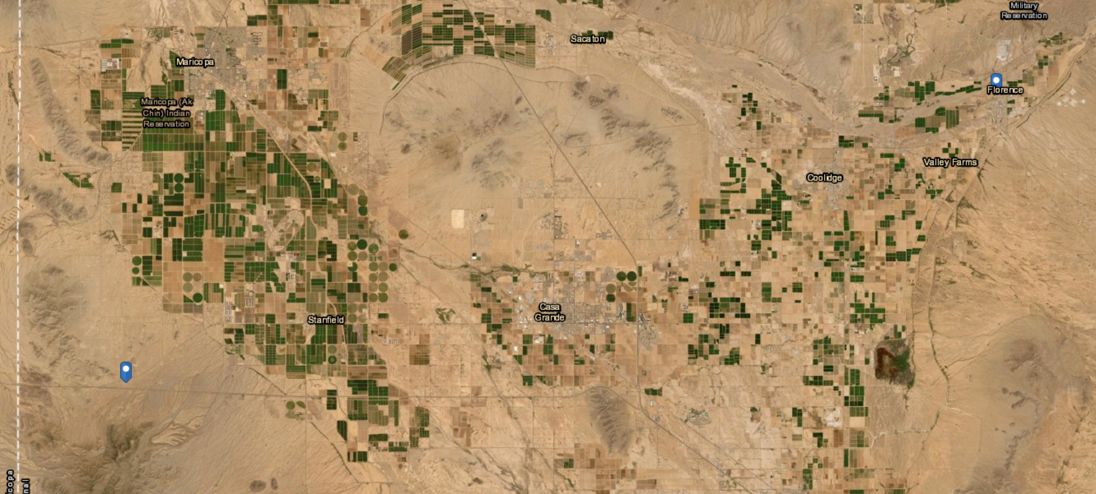
Landing
Takeoff
Flight Path Base Map, 2019
Notes:
Markers denote launch site on the left and historical landing sites on the right.

Slide 13
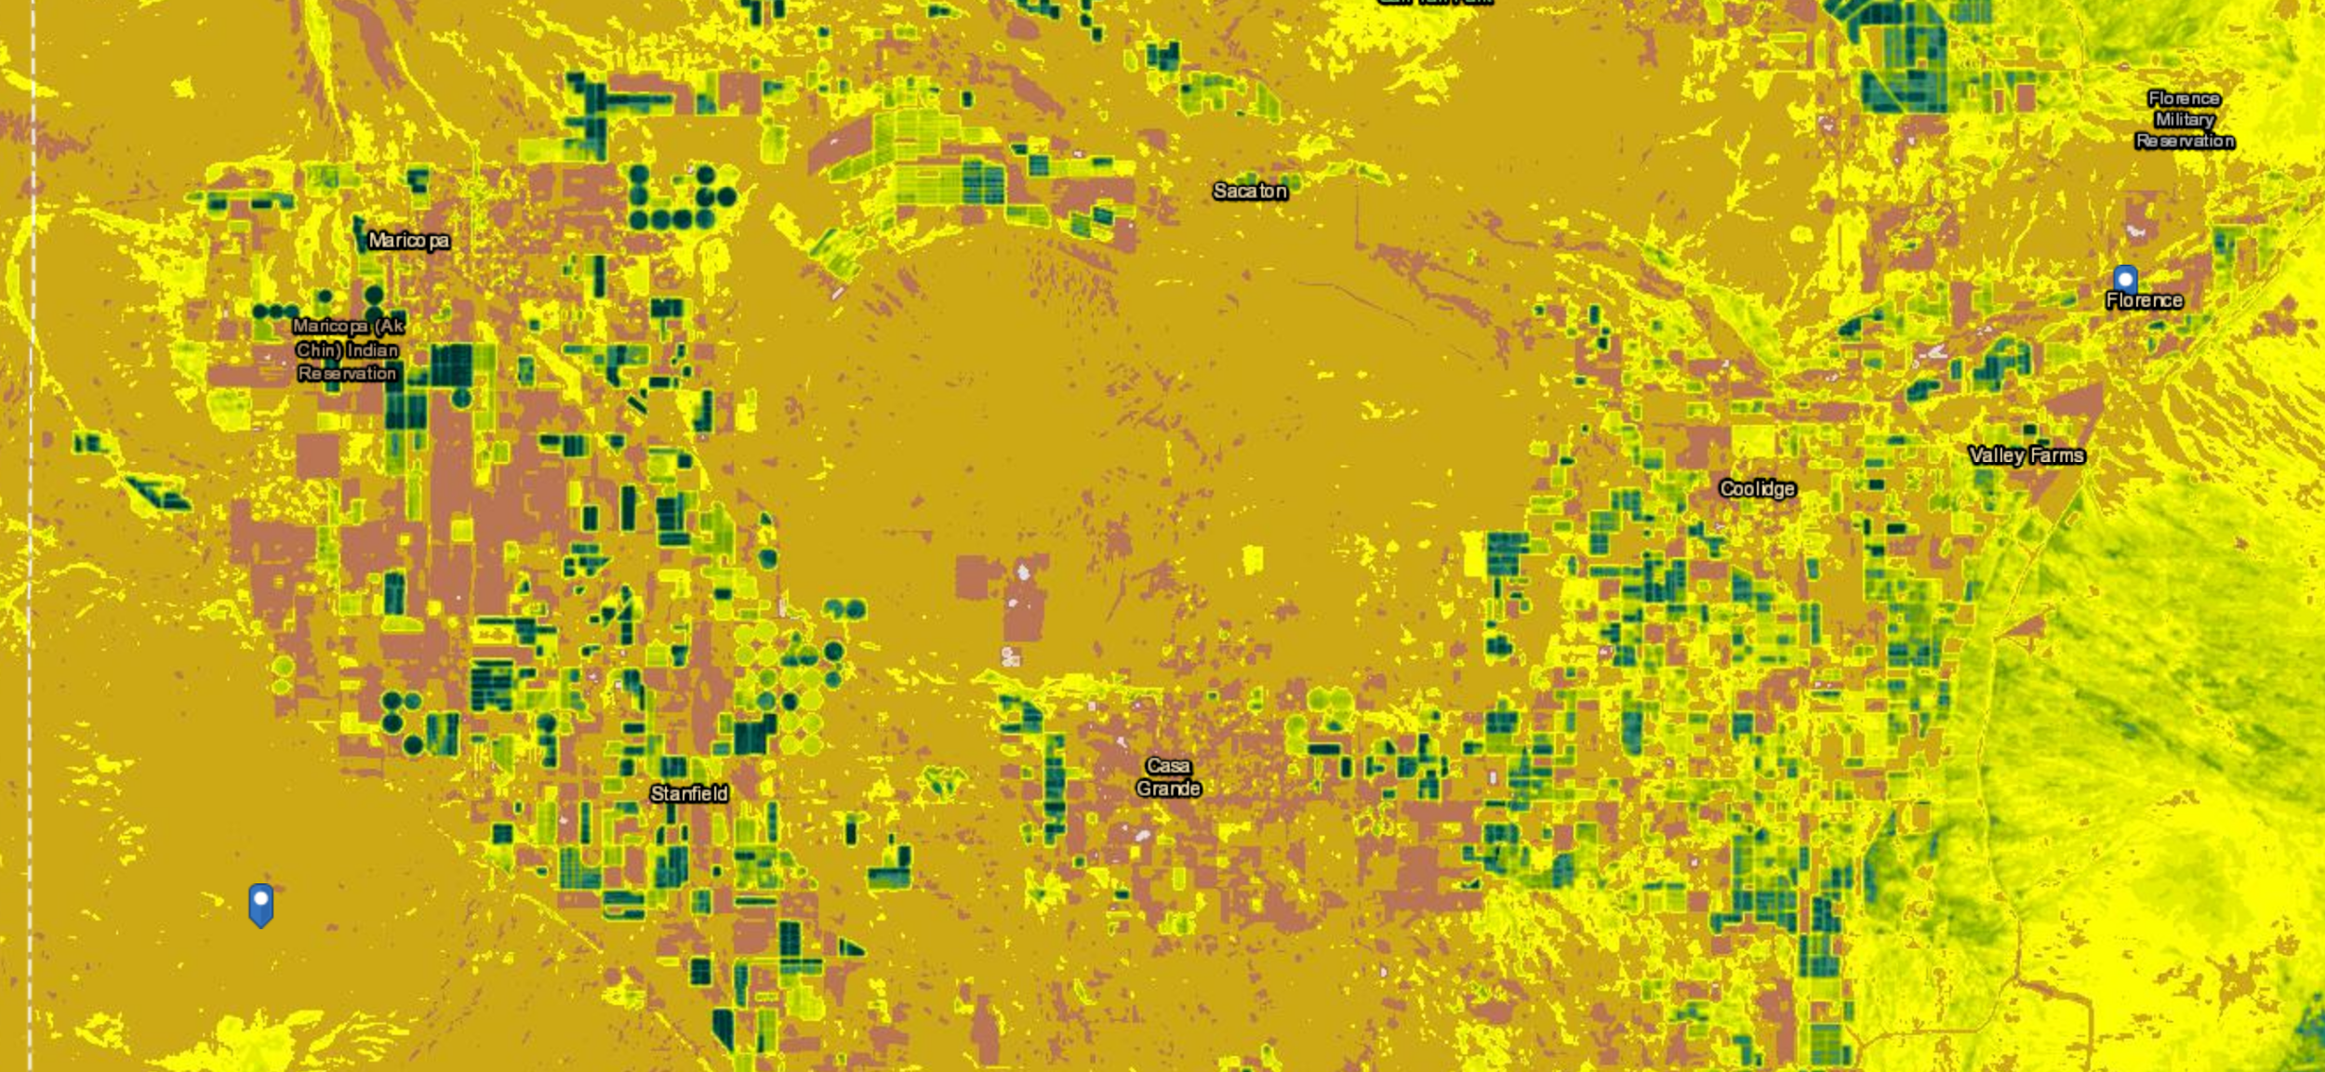
Flight Path Vegetation Index, 2019
Notes:
Markers show historical launch and landing sites left to right.

Slide 14
Observations and Hypothesis
NDVI data that is publicly available has insufficient data to draw meaningful conclusions for counties that desire more granular reporting
Initial observations show that Pinal Park ranks low on NDVI when observed from arcGIS
Produced the following hypothesis
Taking NDVI at lower measurements on low-cost, open source hardware and software is a cost-effective manner of charting vegetation indexes for municipalities

Slide 15
Experiment Setup
Dual Raspberry Pi 0 Cameras pointed Downward to Capture NDVI Images
Launch payload with additional runcam
Leverage open source Python Libraries in order to perform NDVI calculations
Aggregate data from Pixhawk and Raspberry Pi NTP in order to reconstruct mission
Compute optimal height for taking photos using this method
Create guide for schools and municipalities to use

Slide 16

Results
Flight postponed until further notice
Unable to finish construction of payload due to school shutdowns
Calculated cost of experimental electronics payload suite was under 100 dollars for options without Pixhawk 4
Users can substitute Pixhawk for Roblox NEO-6M GPS and obtain similar results
Working on making a parts list and starter code available on Github

Slide 17
Thank You!
Special Thanks to:
Thomas Sharp, Desiree Crawl, Alexa Drew, Laura Zimmerman, Susan Brew, Michelle Coe, Arizona Space Grant, ANSR
Questions?

